Slide 1
Father’s Impact on Children; Consequences for Social Development
Role of the Family for Strengthening Social Development/UN Commission on Social Development, Permanent Mission of Qatar, UN NGO Committee on the Family
11 February 2016 NYC
Kyle D. Pruett, M.D.
Clinical Professor of Child Psychiatry, Yale School of Medicine

Slide 2
It is the primary task of every society to teach men how to father. - Margaret Mead, Anthropologist
Notes:
2
2

Slide 3
Mothering/Fathering well at any age
Sensitivity to needs
Make children feel adored/valued
Sustaining values
Disciplining to teach, not punish
Affirm uniqueness/expect competence
Promote education as process (lifelong)
Safeguard family rituals, relationships and routines

Slide 4
But mothers and fathers do not parent their children in the same ways…
..especially across the life span of the child
infancy, toddlerhood, preschool, school age, adolescence, young adulthood, etc.

Slide 5
Parents’ Average Relationship Adjustment Over Time
130
125
120
115
110
105
M
A
R
I
T
A
L
S
A
T
I
S
F
A
C
T
I
O
N
100
95
90
85
80
0
0.5
1.5
3.5
4.5
5.5
6.5
9.5
14.5
Child’s Age
Notes:
5
5

Slide 6
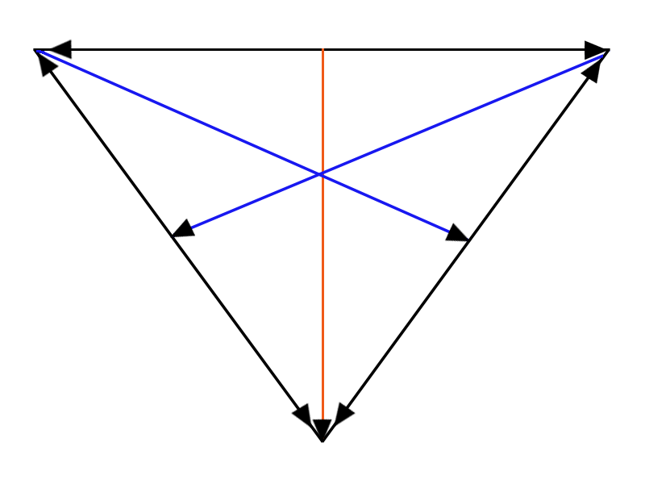
…perhaps due to this familial dynamic
Coparenting ≠ couple systems
Mom Dad
Child
Notes:
6

Slide 7
‘Attachment’ Relationships to Fathers vs. Mothers
Secure attachment to mother provides ‘comfort when child is distressed’.
Father provides security in context of monitored controlled excitement through sensitive and challenging support ‘when child’s exploratory system is aroused…or when child is on the edge of coping’.
and we know that children form…

Slide 8
…multiple ‘attachments’
Fathers more involved in childrearing than ever before
Grandparents are involved across many social classes and cultural groups
Daycare/educare/extended family providers are involved early
Each of these significant relationships play a dynamic (cumulative?) role in family-based child rearing/‘attachings’

Slide 9
Evidence that Children Respond Directly to Men
6 wk olds respond differently to mother/father
Toddlers use clearer behavioral cues to father
Preschoolers use more advanced speech with fathers
Notes:
9

Slide 10
Distinguishing Maternal/Paternal Behavior Trends
Preference for activation/stimulation vs. soothing/comforting
Unpredictable vs. regulating style
Preparation for place in the world vs. relationships
Discipline: ‘real world’ vs. relational adaptation
Frustration tolerance vs. facilitating
Notes:
10

Slide 11
Evidence that Men Respond to Children
Biological response to colicky infant
Touch and smell recognition
Spontaneous speech patterns

Slide 12
Father-Child Interactions
Unique maternal vs. paternal comfort-seeking behavior depending on age
Role of “first significant other”
Importance of play and frustration management in paternal intimacy
Adolescence and ‘limit setting’
Strongly promoted by partner support and culture

Slide 13
Child Outcomes of Involved ‘Fathering’
Behavioral
Reduced contact with juvenile authorities
Delay in initial sexual activity
Less reliance on aggressive conflict resolution
Educational
Higher grade completion and income
Math competence in girls
Verbal strength in boys and girls (literacy)
Emotional
Greater problem-solving competence, and stress tolerance
Greater empathy and moral sensitivity
Most outcomes observed by mid-late-adolescence
Notes:
13

Slide 14
Adult Male Outcomes of Involved Fathering
Increased:
Longevity
Length of marriage
Level of health
Responsibility for relationships
Decreased:
Accidental death
Suicide
Job Change
Aggression/impulsivity

Slide 15
… and a new brain?
Neurobiological changes seen on Magnetic Resonance Images at 2 weeks that are different than moms
Highly involved fathers showed enhanced activity in regions of brain associated with:
1) bond formation
2) auditory processing, especially with own baby’s cry
3) discriminating between crying/laughing

Slide 16
Other new perspectives on fathering
Paternal Post-partum depression
British Longitudinal Study of Parents/Children
Father: 8000 interviewed at 8 weeks, 21 months
Fathers; 3.6% anxiety, mood swings, irritability and hopelessness (Depression)
Mo findings: 9.8% [not married to above]
Child Outcomes: interviewed at 42 months.
emotional/behavioral symptoms, esp. boys (2X)
worry, sadness, hyperactivity

Slide 17
Risks to Fatherhood
Poverty
Unemployment/Guilt
Inexperience
Isolation
Exclusion from child’s life
[divorce, ‘gatekeeping’, child care/health/educational settings]
Work-family stress transcends gender, especially for men

Slide 18
Definition of Gatekeeping
The support or barriers mothers create for fathers’ relationships with their children
Recognizes mothers’ typical control over fathers’ access to children in families
Potential reasons: to ‘protect’ the children; mothers’ frustration with the father

Slide 19
Research on paternal effects on child outcomes is far behind
‘Practitioner Review: engaging fathers-recommendations for a game change in parenting interventions based on a systematic review of the global evidence.’
C Panter-Brick, A Burgess, M Eggerman, K Pruett, J Leckman, JCPP, 55, 11, Nov 2014
Of 786 articles on parenting interventions in global literature, only 199 presented ‘evidence’ on paternal participation
Vast majority recorded evaluation of mother-child dyad only, indicating pervasive deficiencies in way that interventions are designed, delivered, and evaluated, with serious myopia toward coparenting issues within agencies, families and institutions
- An effort at meta-analysis via a handsearch of UNICEF databases on child neglect and fatherhood parenting programs, as well as Childwatch, WHO, World Bank, Global Child Development Network, African Child Policy Forum failed because of the lack of gender-differentiated data reporting

Slide 20
When scientific standards are met; child and parent outcomes are obvious and encouraging when coparenting is supported and evaluated
“Supporting Father Involvement” (C & P Cowan, and M & K Pruett, California’s Office of Child Abuse Prevention); a coparenting approach to supporting paternal engagement early in the lives of at-risk families (migrant workers, etc.)with young children.
RCT model showed reductions in 1) harsh parenting, 2)anxiety and depression in parents, 3) violent problem solving, 4) behaviour problems in children and increases in 1) income, 2) paternal engagement, 3) parental satisfaction, 4) academic performance in school (being replicated in Canada, UK, Eastern US)

Slide 21
How to implement change?
Father engagement and effectiveness can happen quickly and positively;
an unequivocal engagement with coparents [some of whom are fathers, some married, some not – but still coparents]
making parenting interventions culturally compelling to fathers and mothers requires redesign and retraining given the incontrovertible evidence that fathers effect families positively or negatively.
Many programs unintentionally marginalize fathers by procedures and attitudes that disinvite them from the outset. Start with an inventory of ‘father friendliness…’

Slide 22
So, does that first slide make more sense now?
…might fathers be the most powerful untapped resource in the lives of the world’s children?

Slide 23
It is the primary task of every society to teach men how to father. - Margaret Mead
Notes:
23
23

